Slide 1

Project SAMs
Smart Agricultural Monitoring System
(Connectivity)

Slide 2
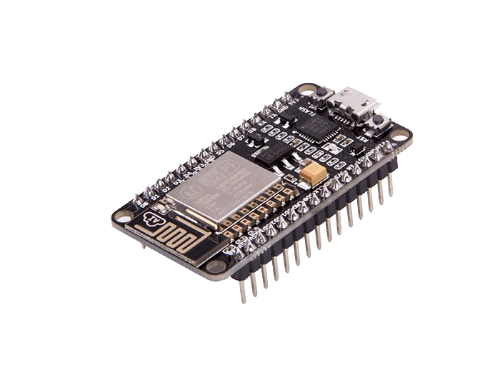
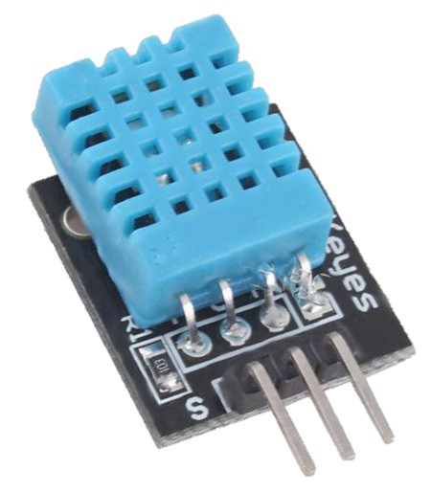
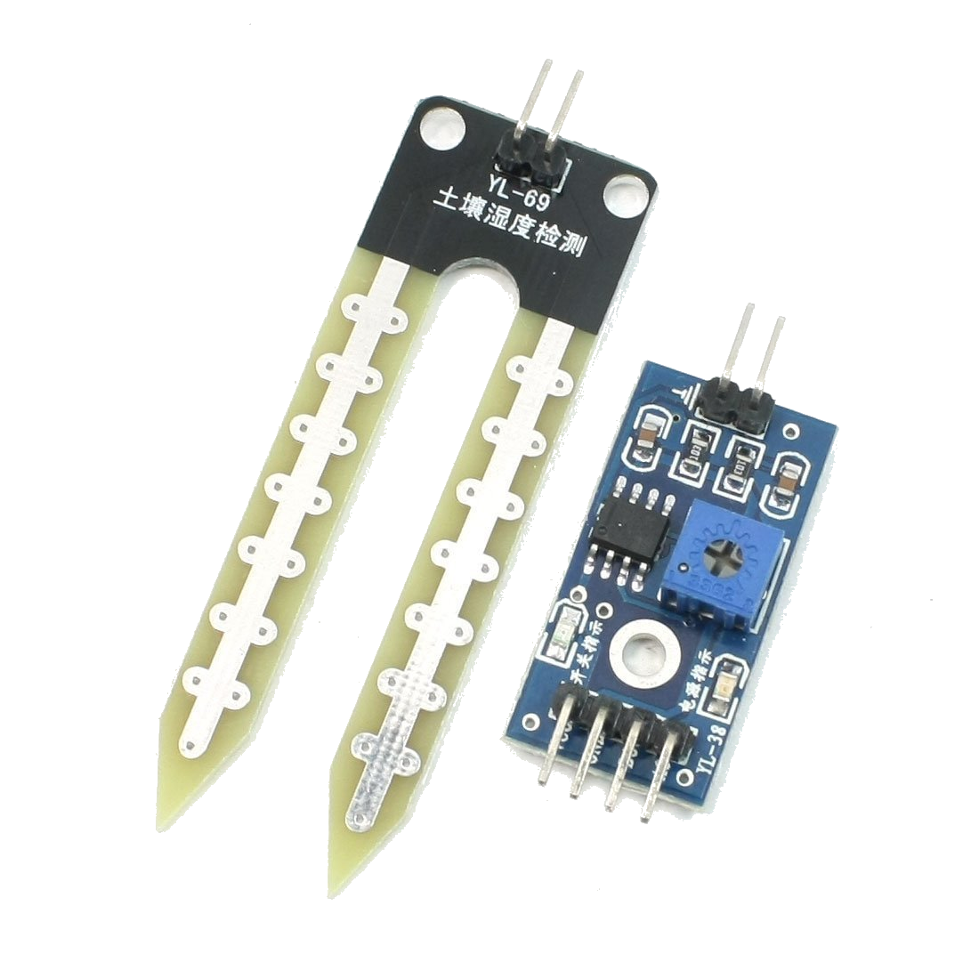

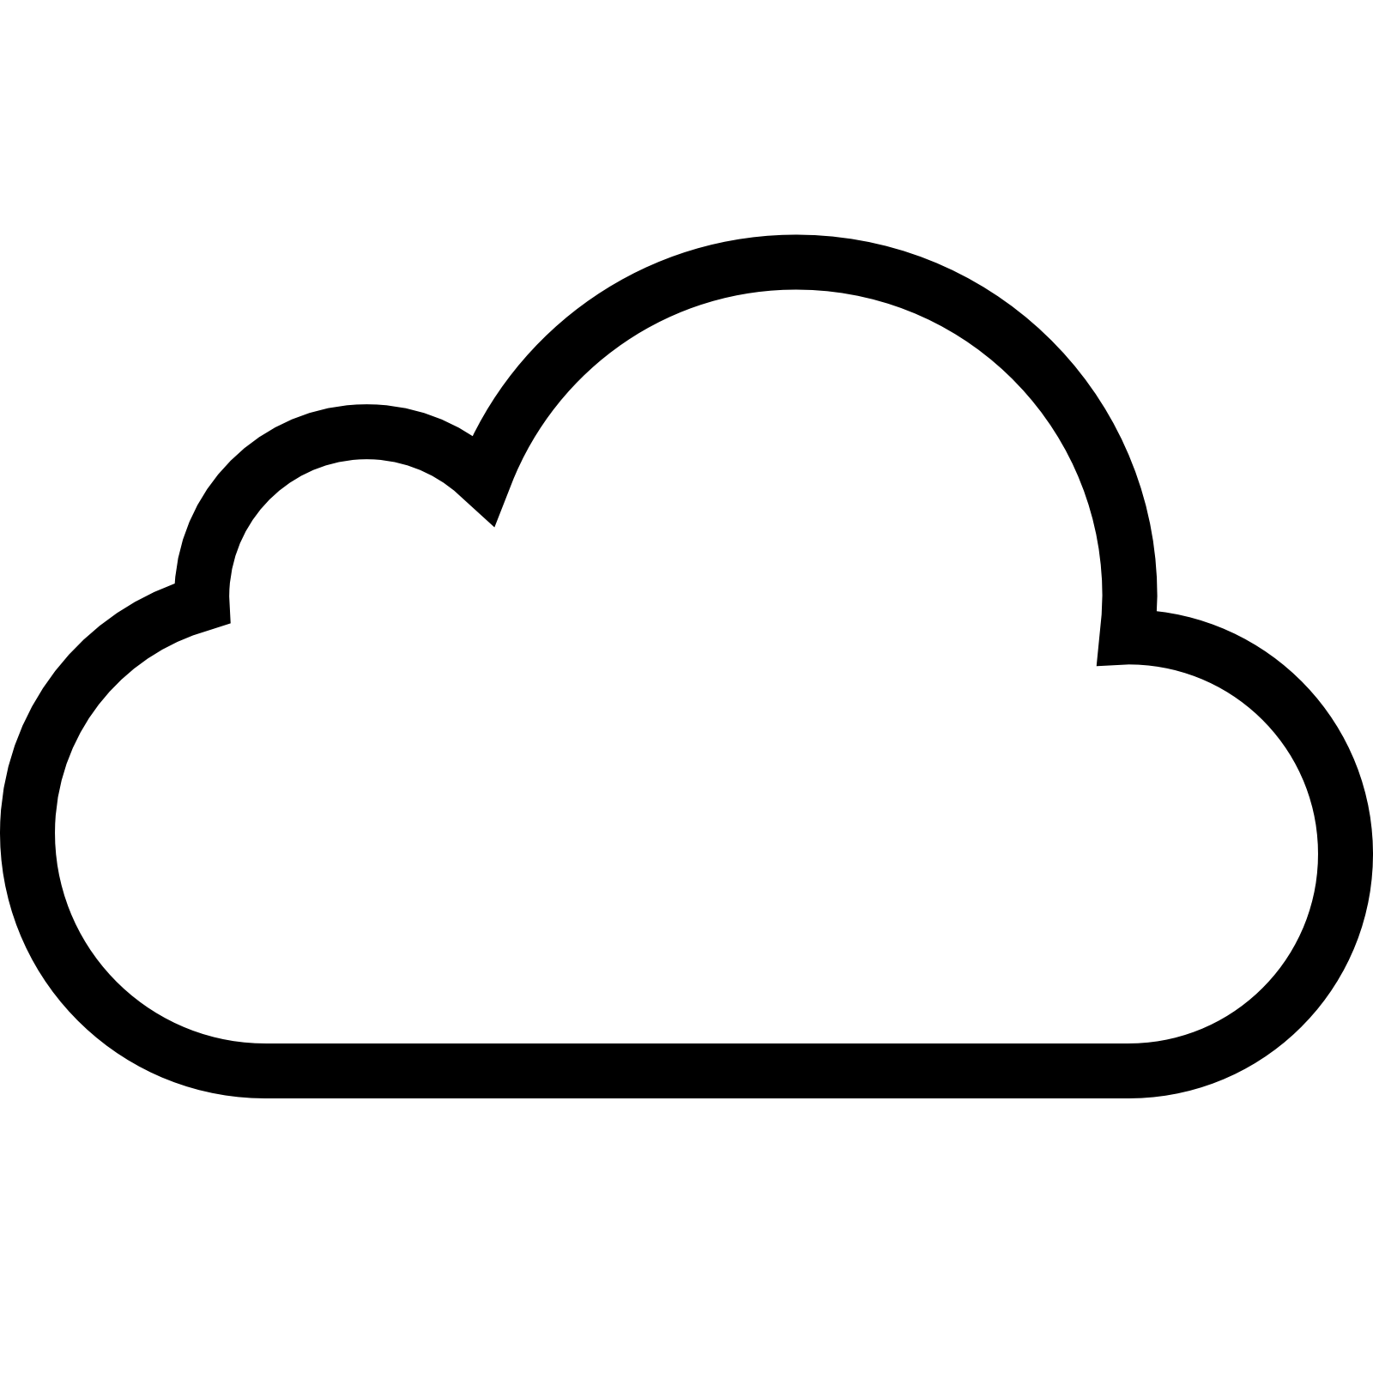

Hardware in current in prototype
NodeMCU ESP8266-E Microcontroller
DHT11 – Humidity & Temperature Sensor
Soil Moisture Sensor
Extra Requirements
Internet Connectivity
Blynk Could Integration
Power Source
Blynk

Slide 3
System Overview
Microcontroller
App
Transducer
Cloud
API
State
Website

Slide 4


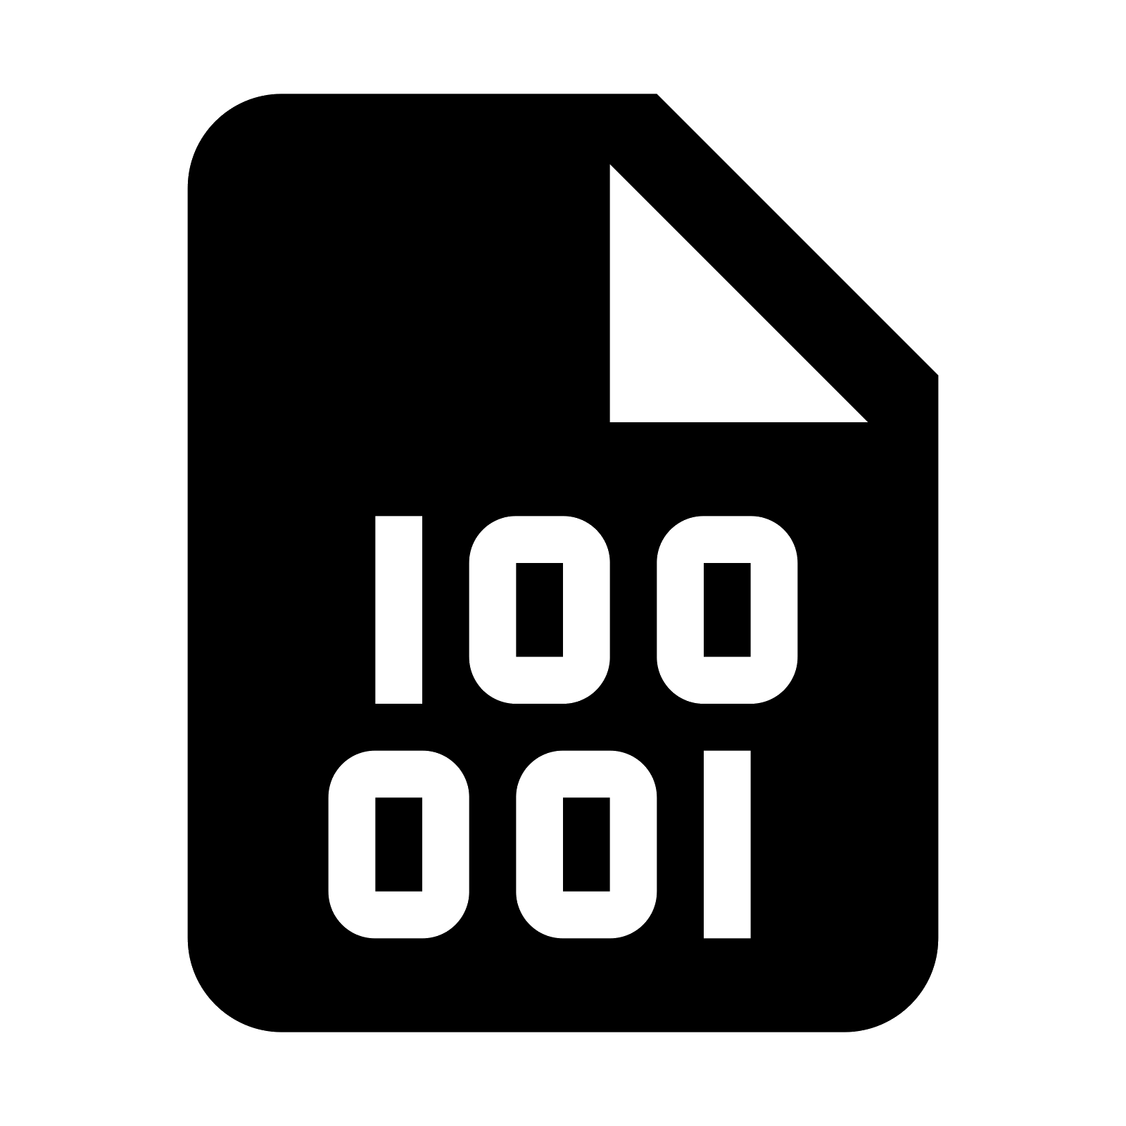

Deployment Overview
Blynk IoT App
GitHub Pages
Temperature
HTTPS GET
Humidity
API
Website
State
Soil Moisture
Blynk
Blynk Cloud

Slide 5
In Short
Data is collected by the sensors (DHT11 and Soil Moisture).
The data is passed to the microcontroller.
The microcontroller has network connectivity and runs the Blynk IoT Client.
The microcontroller hence pushes the data to Blynk Cloud.
Blynk cloud logs the data and provides API for connectivity.
The data can be accessed via the Blynk IoT app.
The can also be accessed via API calls.
Our web dashboard is hosted on GitHub Pages.
Our web dashboard makes API calls to Blynk cloud to pull the data.
The system is near-realtime.

